Slide 1
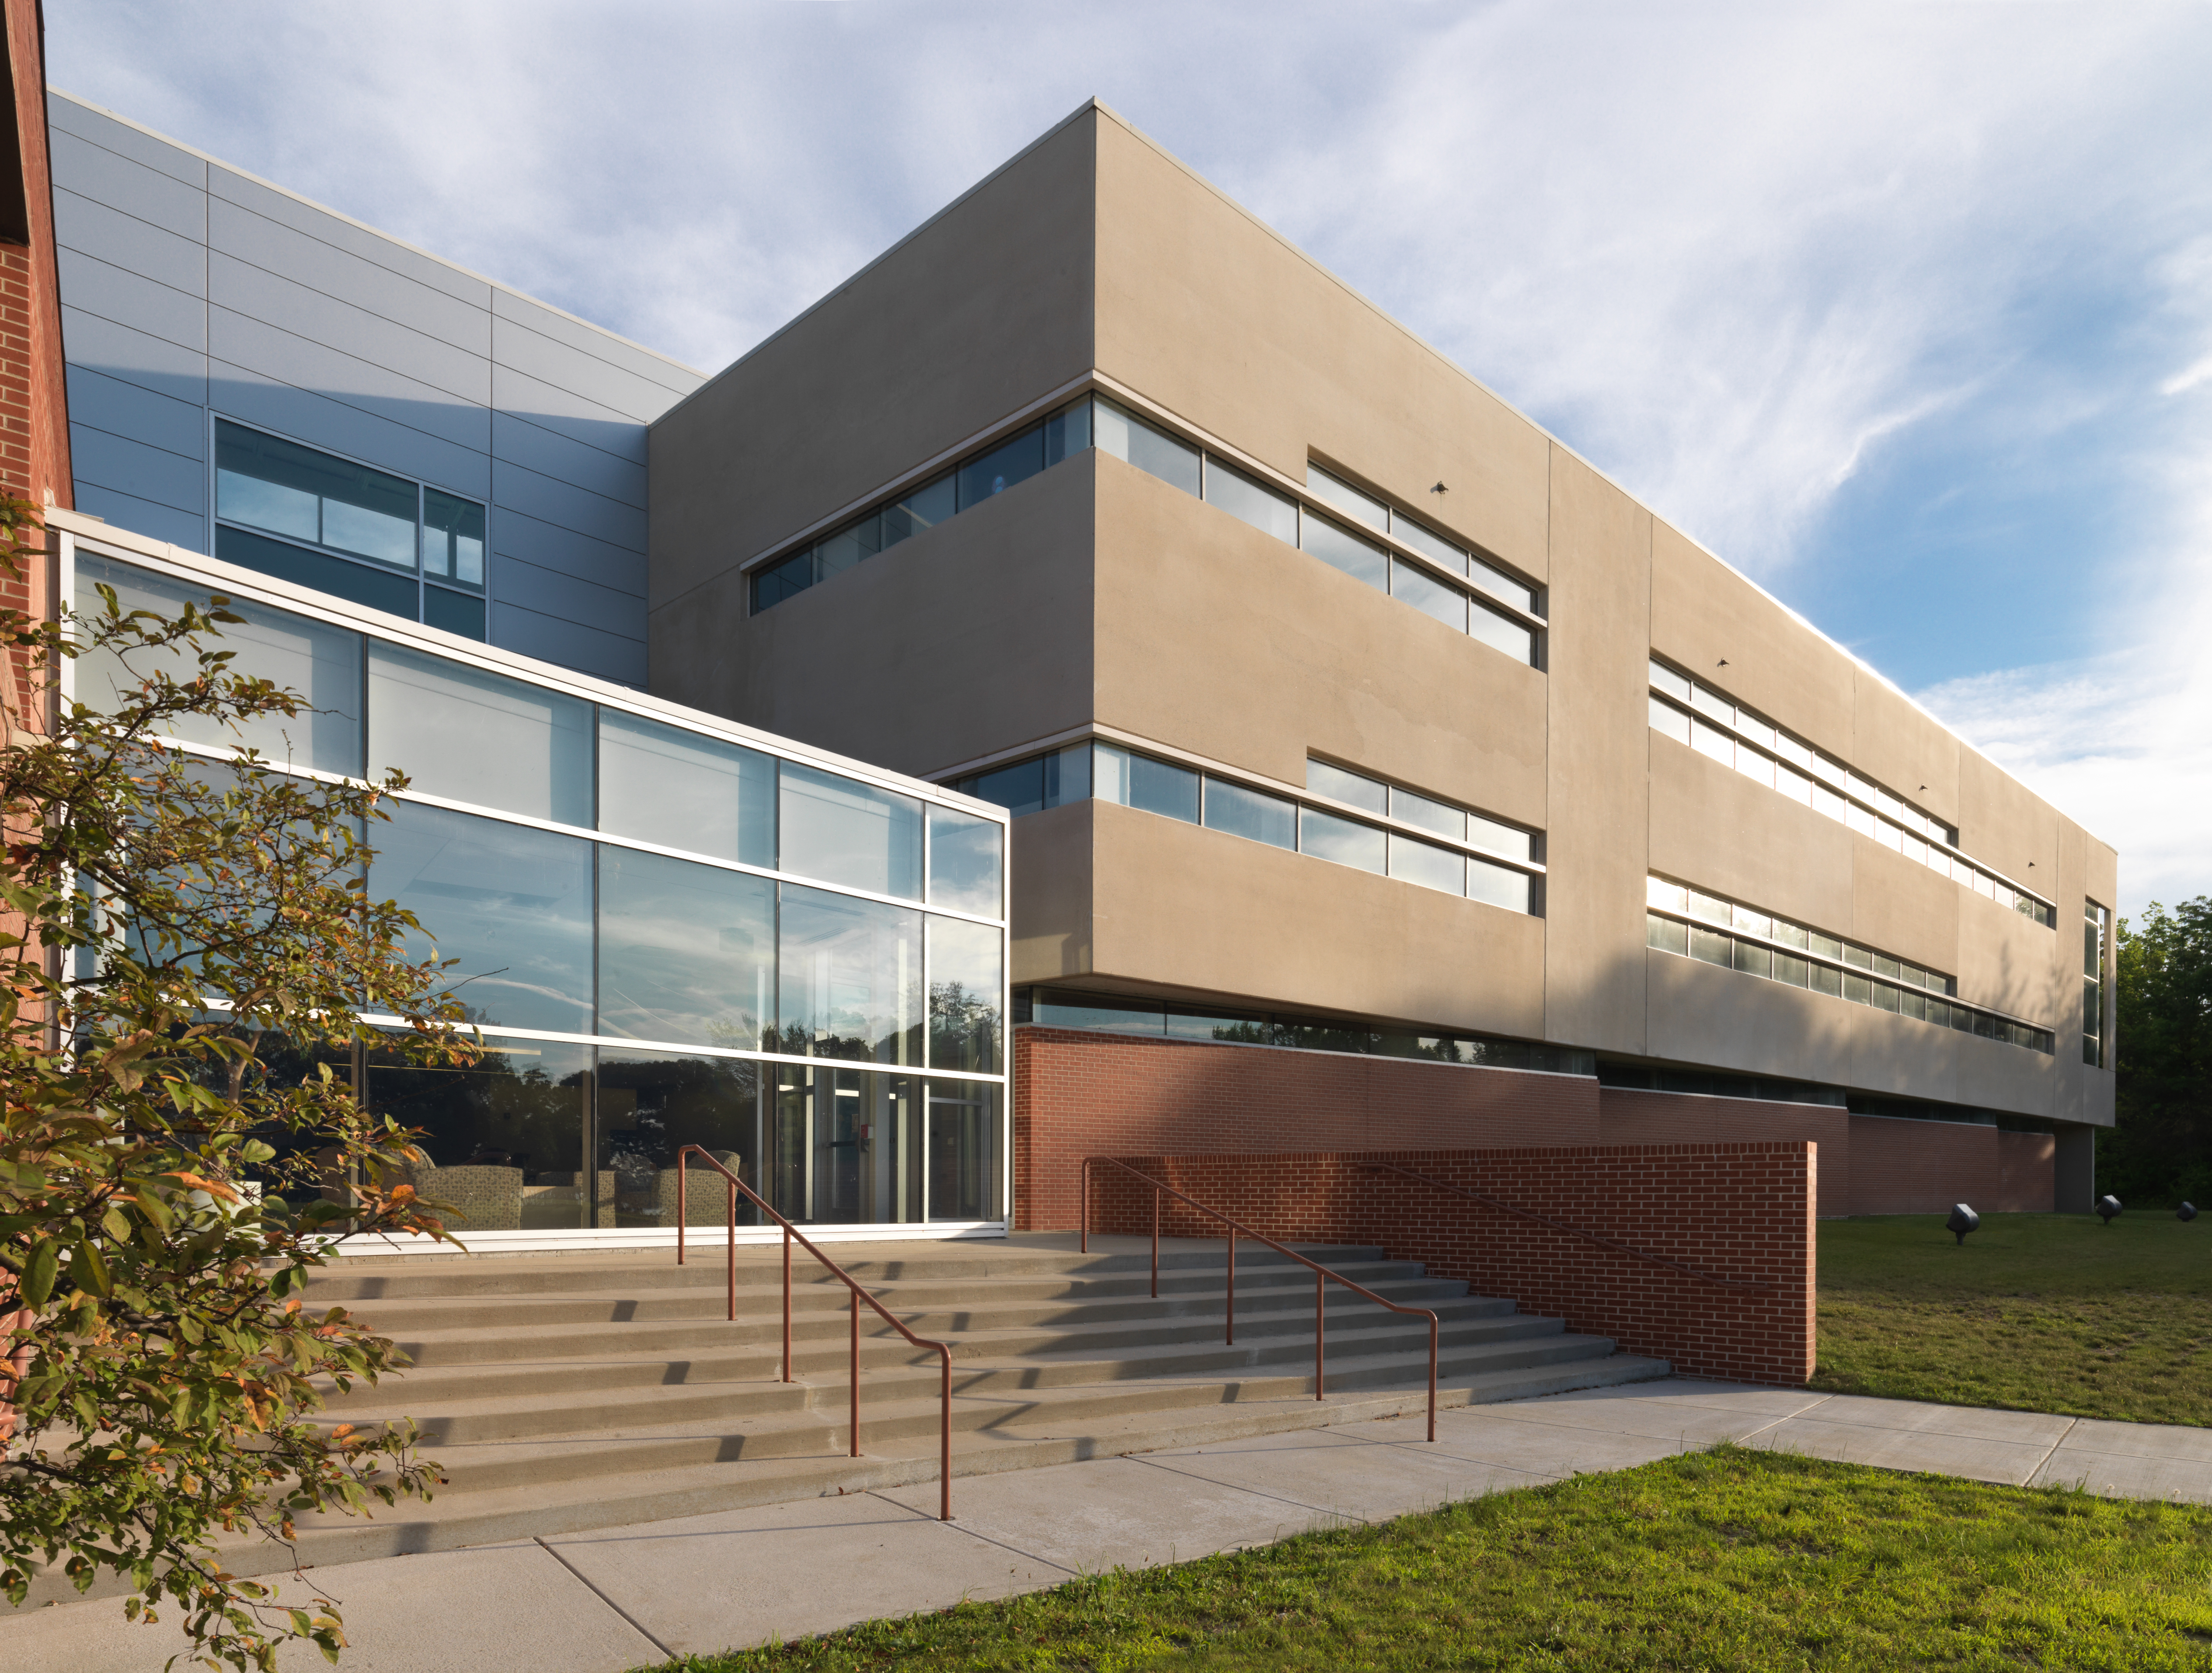
Presentation Title Goes Here and Should Not Be Longer Than Two Lines
Presenter Name
Presenter Title

Slide 2
Title slide
An appropriate image has been provided for your presentation based the KCC look and feel.
You can replace the Title Slide image with your own image if you want.
  Right-click the Title Slide background (not a content box).
  Browse to the image you want to place (Insert From: File).
  Click the Close button.
  Your image should be sized to 1,920 x 1,080 pixels and saved as a JPEG or PNG file.

Slide 3
Choosing a screen format
This is the widescreen size – 16x9
You can also select a 4x3 (standard) format
  Go to the Design tab, select Page Setup, choose the slide size

Slide 4
Class summary
Class summary text goes here
Insert a short summary of the class.
This provides an outline of what you intend to cover and ensures that attendees are in the correct class.

Slide 5
Class summary
The student will relate effective communications to successful management. He or she will describe and apply positive qualities and techniques of effective written and oral communication and will construct, present, and explain functional types of business messages including application letters and resumes.
EXAMPLE

Slide 6
Learning objectives
At the end of this class, you will be able to:
Insert learning objective 1
Insert learning objective 2
Insert learning objective 3
Insert learning objective 4
Insert learning objective 5
Make sure that the list of objectives starts with “At the end of this class, you will be able to:”
Begin each learning objective with an action verb: “describe,” “create,” “add,” “edit,” and so on.

Slide 7
Learning objectives
At the end of this class, you will be able to:
Relate effective communications to successful management
Describe and apply positive qualities and techniques of effective written and oral communication
Construct, present, and explain functional types of business messages including application letters and resumes
EXAMPLE

Slide 8
Section slide
Break-up presentations into sections of almost equal length. This enables your students to more easily follow your presentation. Also, if the presentation is recorded, it makes it easier to pinpoint specific content. Use this slide to introduce each section.
See the example on the next slide.
Tip: Section titles will often reflect your learning objectives.

Slide 9
Writing effective communication
EXAMPLE

Slide 10
Writing guidelines
Always include slides for the introduction and summary
At the beginning of the presentation, include a class summary slide and a slide listing your learning objectives. Close your presentation with a summary slide of your main points, calls to action, recommendations for further study, contact info, and so on.
Structure and break-up your content
Break your presentation into distinct sections, based on your learning objectives. Distinct sections make it easier for attendees to comprehend the whole as well as the parts.
Write clear, actionable learning objectives
Start each learning objective with an action verb like “Define” “Create” “Add” and “Edit” to show attendees what they will be able to do after completing the class. Avoid weak verbs such as “understand” or “comprehend.”

Slide 11
Writing guidelines (cont’d)
Use both visuals and text
To get your message across to both left- and right-brain thinkers, make sure your slides have both visuals and text. Visuals can include photographs, diagrams, charts, and illustrations.
Less is more: write in point form, not complete sentences
If you have too much text on your slide, the audience spends too much time reading, not listening. Use single words or phrases rather than sentences. Bullet points are talking points, not a script.
Example:
Poor: Be sure to take care when you are deleting Object Data from objects in your CADD drawings.
Better: Take care deleting Object Data

Slide 12
Writing guidelines (cont’d)
Use the 5-by-7 rule
Your slides should have no more than 5 lines of text with each line having no more than 7 words. This keeps your text slides clean, appealing, and more readable. If you find yourself writing lengthy slides, move more text to the Speaker’s Notes, and reduce the text on the slide to the essential points.
Treat the heading of each slide as valuable real estate
Make your headings specific and meaningful. Your slides should have short, powerful headlines that summarize the information on the slide. Use title-style caps with no ending punctuation.
Example:
Guidelines for Effective Communication

Slide 13
Writing guidelines (cont’d)
Restrict titles to a single line
Do not extend slide headings to two lines. It diminishes the impact of the message if the subject can’t be conveyed quickly.
Use language that relates to the audience’s interest
Avoid jargon and overly complex information that detracts from the main message.
Present data in an uncluttered way
Make labels clear and easy to read. Avoid any visual element that does not directly communicate your message.
Make sure slide images support the main message of the slide
Random clip art does not reinforce your point and distracts from your main message.

Slide 14
Writing guidelines (cont’d)
Cite your sources for data
Data cited without a source allows the audience to challenge its credibility. It is a best practice to always cite the source of your information.
Use consistent style for capitalization and punctuation
Use sentence-style capitalization for bullet items, with no conjunctions or ending punctuation.
Example:
  First bullet item has sentence-style capitalization
  Second bullet item also has sentence-style capitalization
  Bullets items are not joined by conjunctions
  Last bullet item has no ending punctuation

Slide 15
KCC logo usage and colors
Use the college logo correctly
Use KCC logos, colors and wordmarks properly. See Marketing Guidelines for logo usage requirements, visit http://www.kcc.edu/FacultyStaff/departments/mediaservices/Pages/Logos.aspx
Navy
0R 51G 91B
Scarlet
168R 12G 53B

Slide 16
Fonts guidelines —Headers are Arial 60 point
Body copy is Arial (Body) 48 point
  Secondary body copy is Arial (Body) 43 point
  Use square bullets instead of round

Slide 17

Full-screen layout
Image size (1,920 x 1,000 pixels)

Slide 18
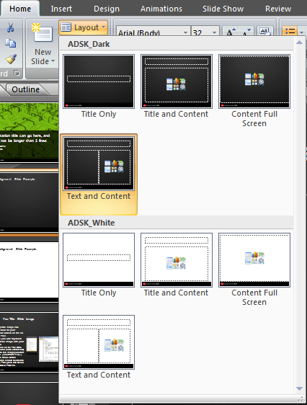
Dark background slide example
Access the built-in slide layouts for this template on the Home tab under Layout.
Click the small triangle to see all the available layouts.

Slide 19
White background slide example
The dark background is preferred for presentation.
White background layouts are also available for presentations and can be in the same presentation as black background slides.
  The white background layout is useful when displaying logos or charts that already have a white background.
White background layouts are also useful for presentations intended for printout.

Slide 20
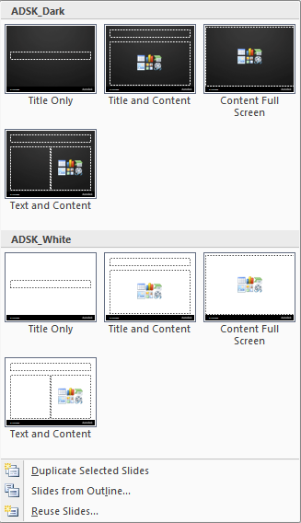
Built-in slide layouts
You can access the built-in layouts via the Home tab.
Click the layout button on the Home tab.
There are four layouts.
You can also add slides by clicking the triangle next to the New Slide button.

Slide 21
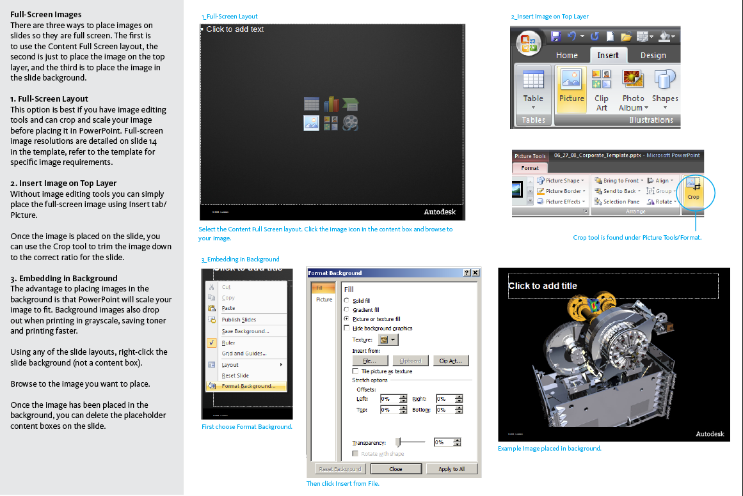
Images
Follow these instructions, borrowed from Autodesk University, to place full-screen images in the KCC PowerPoint template.

Slide 22
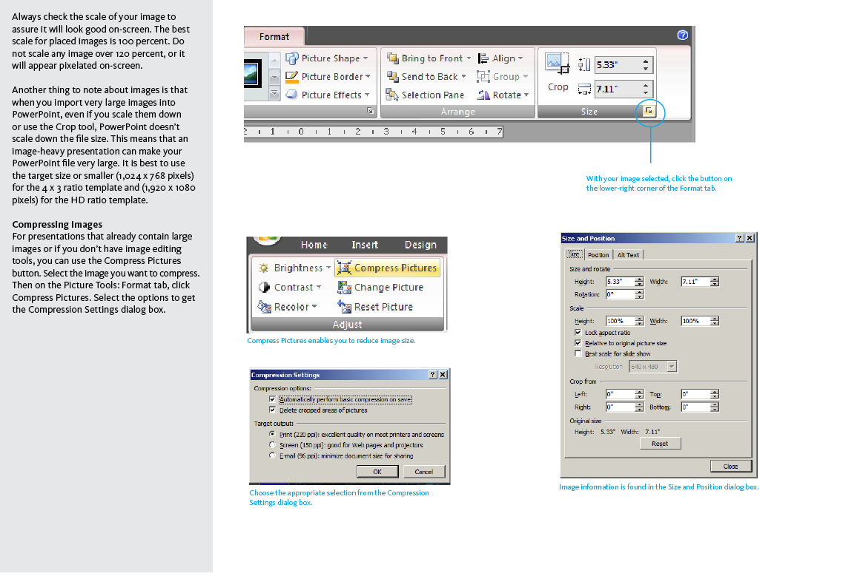
Images

Slide 23

Resizing and rescaling Images
Properly resize images – drag the corner while holding down the shift key
Don’t squish images

Slide 24
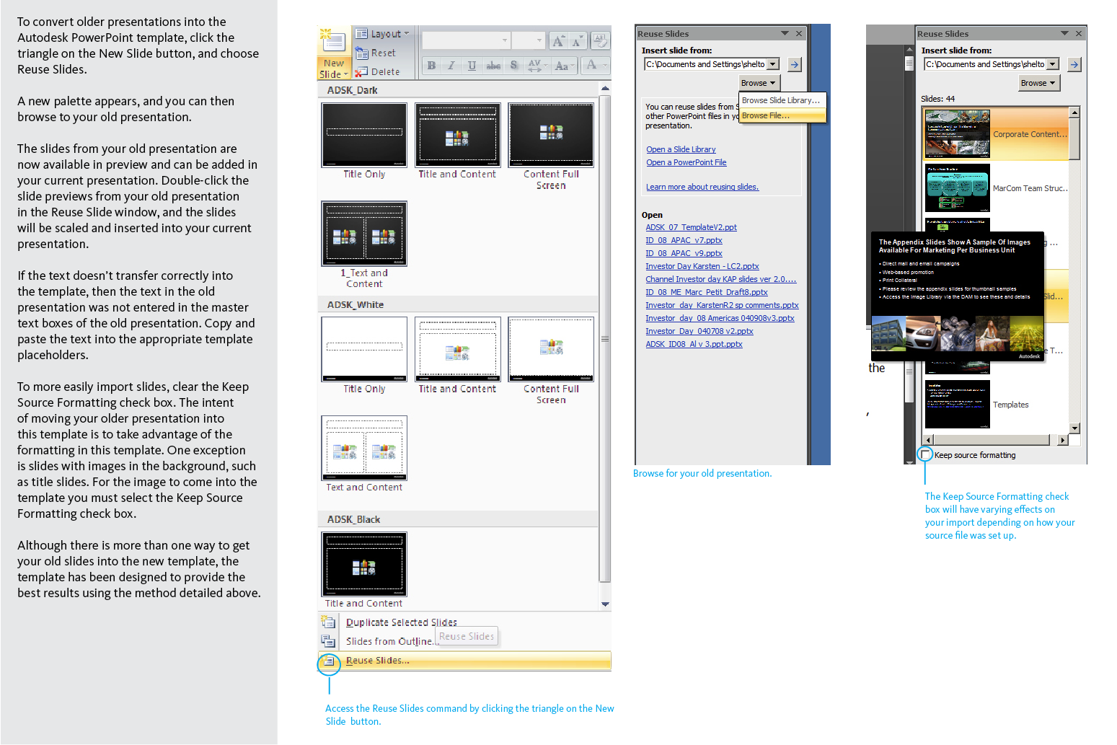
Porting old presentations
Follow these instructions, borrowed from Autodesk University, to convert older presentations into the KCC PowerPoint template.

Slide 25


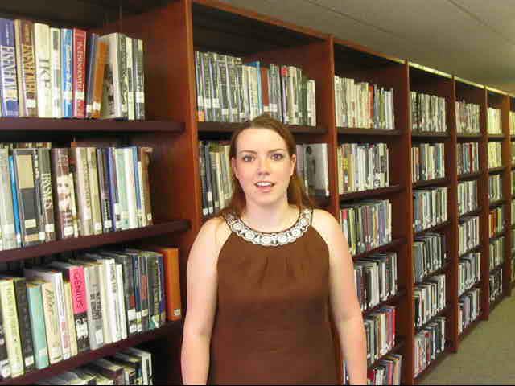
Adding video clips
To insert video, go to the Insert tab on the menu bar, and select Movie. Then browse for the file and select Ok. The clip will appear on your screen.

